Slide 1
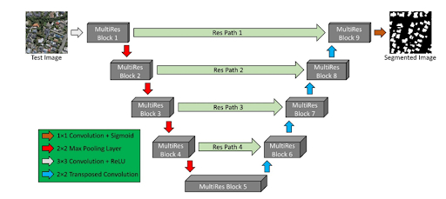
AIRS Dataset
Ground Truth Images
Aerial Images
Clipping of Images
Patches of images
Normalization
Normalized images
BUILDING SEGMENTATION
MultiRes UNet
Segmented building masks
Thresholding
Get Contours
Draw Bounding Box
Buildings with bounded boxes
Background subtraction
Perform Color Filling
EXTRACTED ROOFTOPS

